Slide 1
Smart Veterinary System
with AI-Based Disease Detection
CSE 299 | Section 04 | Group 05
Group 05 | Rishat Bin Sultan, Fariha Islam, Nafia Haque Muskan, MD Tamim Hasan

Slide 2
Project Overview
A comprehensive platform combining veterinary e-commerce with AI-powered healthcare
Project Scope
Team Members
Shop Module: Complete e-commerce for veterinary products
R
Rishat Bin Sultan
F
Fariha Islam
Appointment System: Book veterinary consultations online
2312559042
2311101642
AI Integration: Disease detection using ML models
N
Nafia Haque Muskan
T
MD Tamim Hasan
2311677042
2232239642
Technology Stack
Django
Python
HTML/CSS
JavaScript
Scikit-learn
Key Achievements
Successfully developed a fully functional e-commerce platform with appointment booking system, preparing for AI disease detection implementation.
Group 05 | Rishat Bin Sultan, Fariha Islam, Nafia Haque Muskan, MD Tamim Hasan

Slide 3
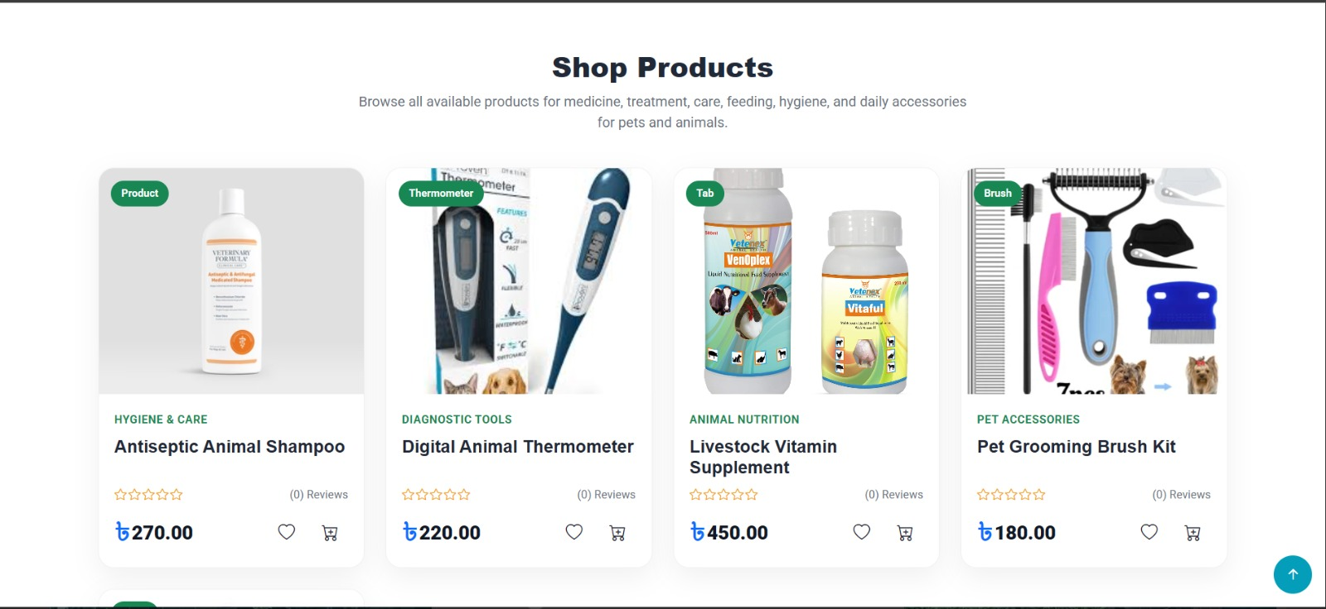
Shop Products Page
Browse veterinary products across multiple categories
Product Categories
Hygiene & Care
Shampoos, grooming tools
Diagnostic Tools
Thermometers, monitors
Animal Nutrition
Vitamins, supplements
Pet Accessories
Brushes, grooming kits
Key Features
Product ratings & reviews
Wishlist functionality
Quick add to cart
Group 05 | Rishat Bin Sultan, Fariha Islam, Nafia Haque Muskan, MD Tamim Hasan
Price display in BDT

Slide 4
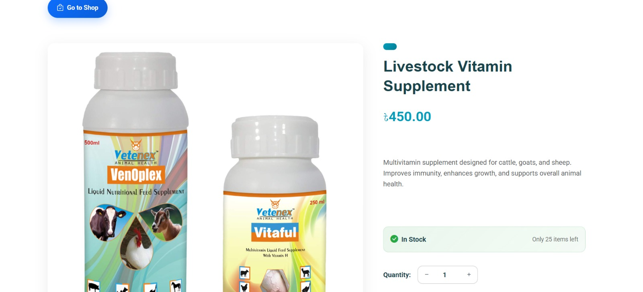
Product Details Page
Comprehensive product information with high-quality images and purchase options
Product Information
High-Quality Images
Multiple product images with detailed viewing
Detailed Description
Comprehensive product information
Stock Status
Real-time inventory display with "In Stock" indicators
Purchase Actions
Add to Cart
Buy Now
Wishlist
Group 05 | Rishat Bin Sultan, Fariha Islam, Nafia Haque Muskan, MD Tamim Hasan

Slide 5
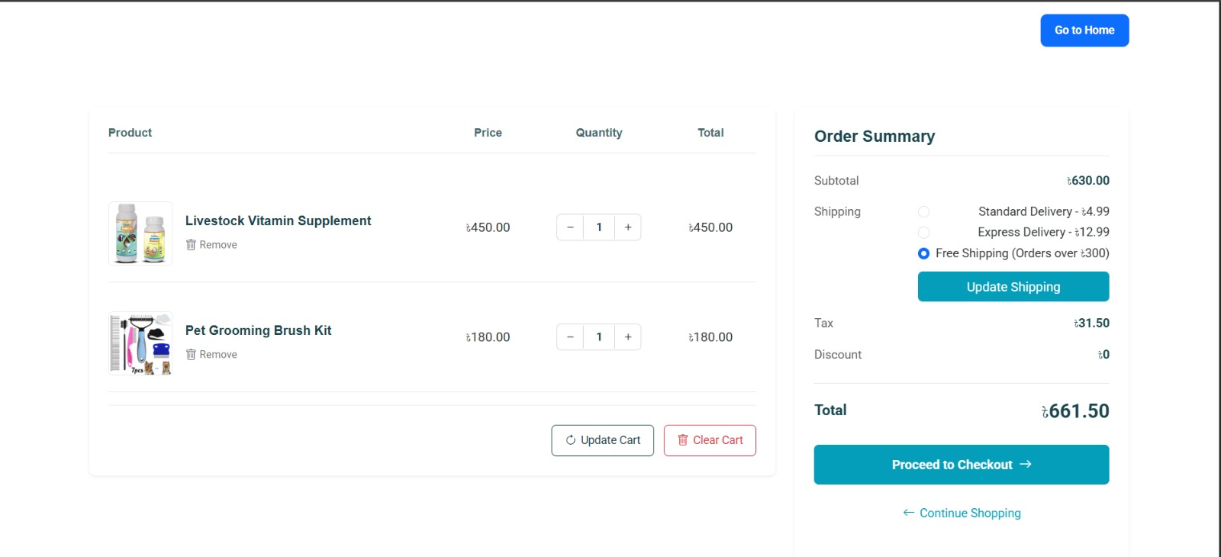
Shopping Cart System
Full-featured cart management with quantity controls and shipping options
Cart Features
Quantity Management
Adjust product quantities with +/- controls
Remove Items
Easy removal of products from cart
Update Cart
Real-time cart updates and calculations
Shipping Options
Standard Delivery
৳4.99
Express Delivery
৳12.99
Free Shipping
Group 05 | Rishat Bin Sultan, Fariha Islam, Nafia Haque Muskan, MD Tamim Hasan
Orders over ৳300

Slide 6
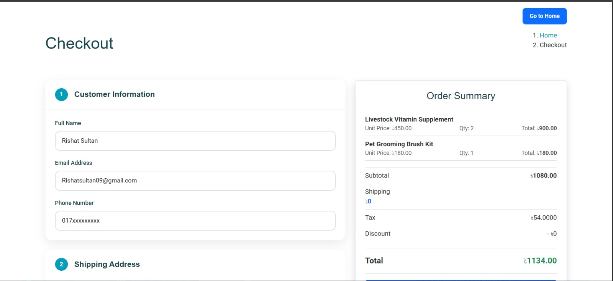
Checkout Process
Streamlined two-step checkout with customer info and order summary
Checkout Features
Checkout Steps
1
Customer Information
Name, email, phone number
2
Shipping Address
Delivery location details
3
Order Summary
Products, Subtotal
4
Final Checkout
Group 05 | Rishat Bin Sultan, Fariha Islam, Nafia Haque Muskan, MD Tamim Hasan

Slide 7
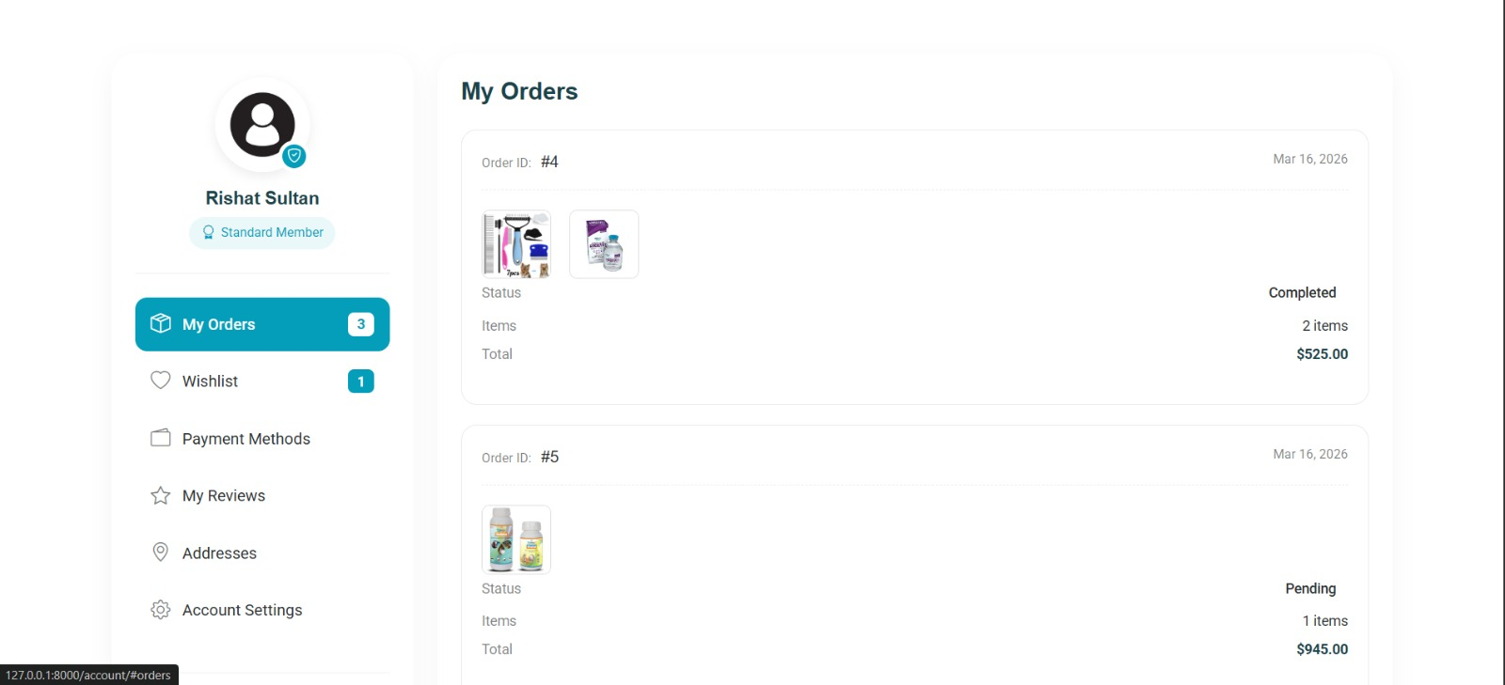
Order Management
Track orders with status updates and comprehensive order history
Order Tracking
Order ID System
Unique order identifiers for easy tracking
Order Dates
Track when orders were placed
Status Updates
Real-time order status (Pending, Completed)
User Dashboard
Group 05 | Rishat Bin Sultan, Fariha Islam, Nafia Haque Muskan, MD Tamim Hasan
Standard Member

Slide 8
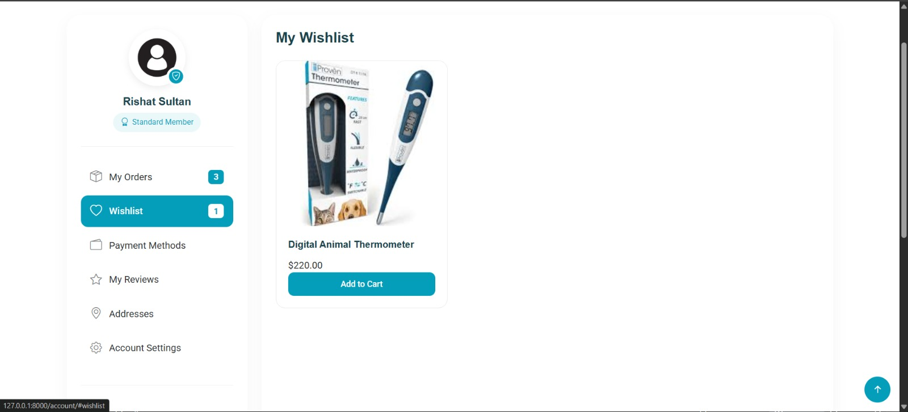
Wishlist Page
Save products for later
Wishlist Features
Save products for future purchase
Quick add to cart from wishlist
Price tracking and updates
Group 05 | Rishat Bin Sultan, Fariha Islam, Nafia Haque Muskan, MD Tamim Hasan

Slide 9
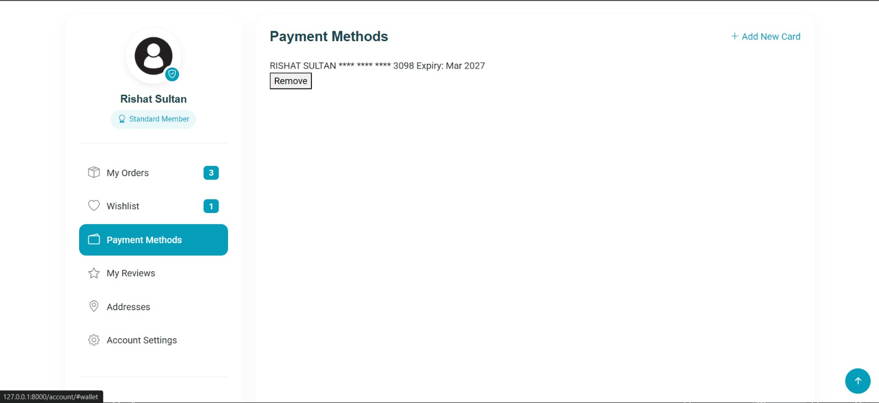
Payment Methods
Manage secure payment options
Payment Security
Masked card numbers for security
Expiry date tracking
Easy add/remove cards
Group 05 | Rishat Bin Sultan, Fariha Islam, Nafia Haque Muskan, MD Tamim Hasan

Slide 10
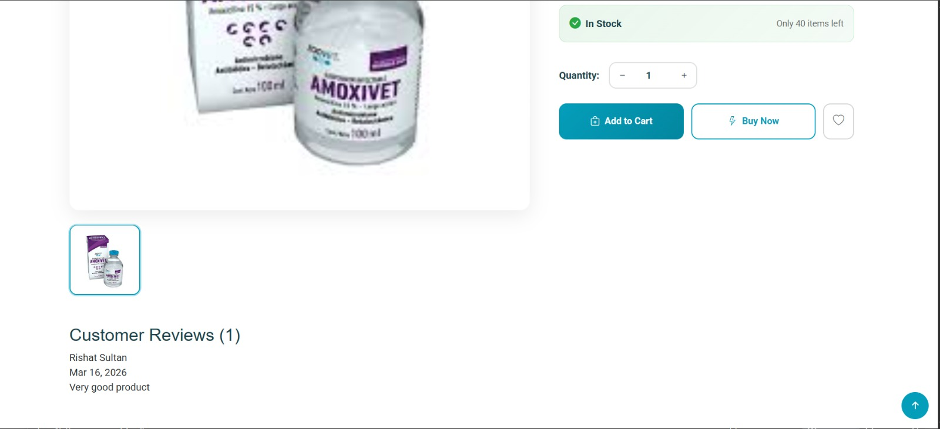
Customer Reviews System
Build trust with transparent customer feedback and ratings
Review Features
5-star rating system
Written feedback support
Product-level reviews
Group 05 | Rishat Bin Sultan, Fariha Islam, Nafia Haque Muskan, MD Tamim Hasan

Slide 11
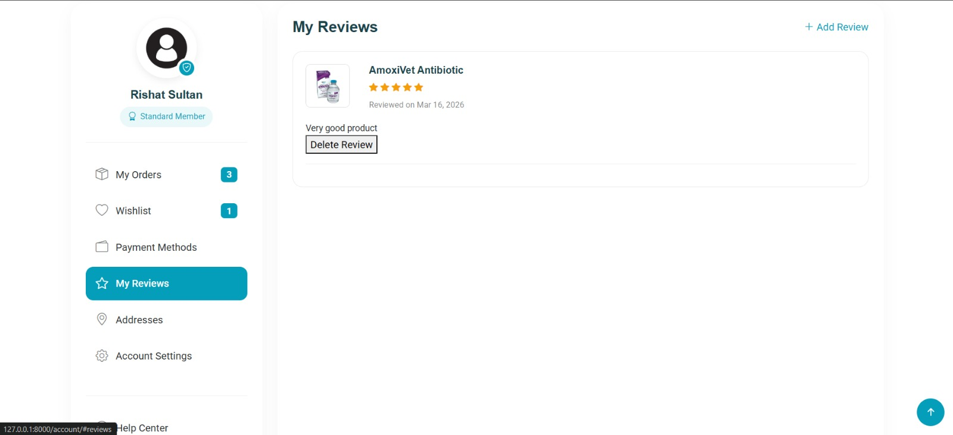
My Review Page
Build trust with transparent customer feedback and ratings
My Reviews
View all submitted reviews
Track review dates
Delete reviews option
Group 05 | Rishat Bin Sultan, Fariha Islam, Nafia Haque Muskan, MD Tamim Hasan

Slide 12
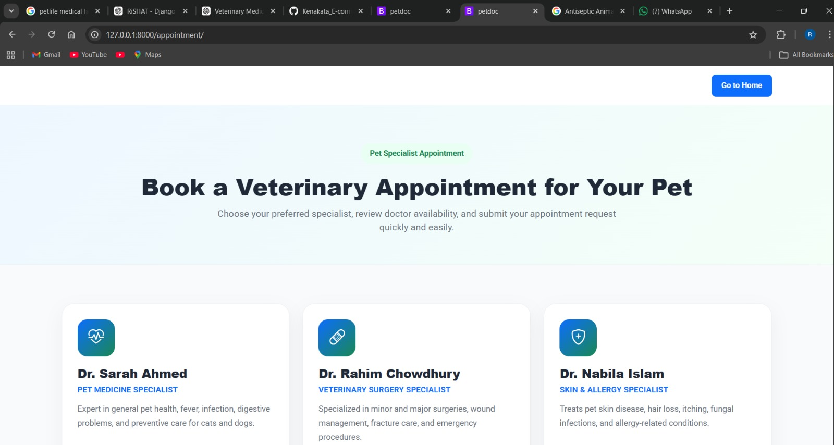
Veterinary Appointment System
Book consultations with specialized veterinarians online
Group 05 | Rishat Bin Sultan, Fariha Islam, Nafia Haque Muskan, MD Tamim Hasan

Slide 13
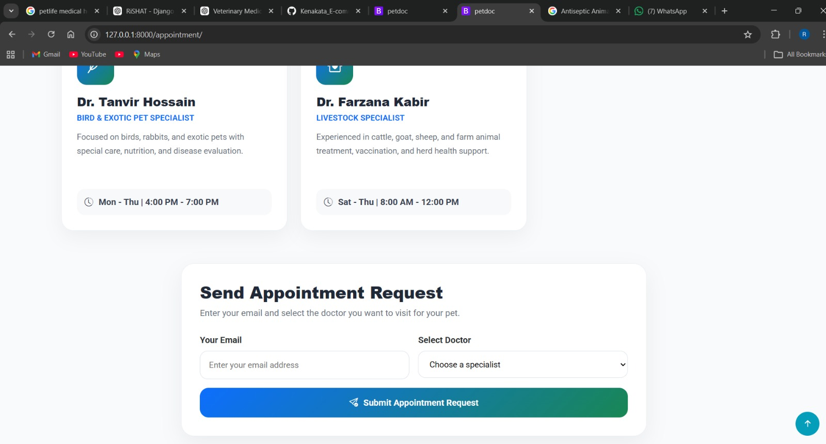
Veterinary Appointment System
Book consultations with specialized veterinarians online
Booking Features
View doctor availability schedules
Simple appointment request form
Email confirmation system
Specialist selection dropdown
Group 05 | Rishat Bin Sultan, Fariha Islam, Nafia Haque Muskan, MD Tamim Hasan

Slide 14
Development Progress & Future Plans
Current achievements and roadmap for AI integration
Completed Tasks
Future Roadmap
R
Rishat Bin Sultan
1
Dataset Collection
Improved shop interface, product display, cart counter
Gather veterinary disease datasets for pets and animals
N
Nafia Haque Muskan
2
Data Preprocessing
Developed appointment booking page for consultations
Prepare and clean data for machine learning
T
MD Tamim Hasan
3
ML Model Training
Backend logic for appointments & database integration
Train disease detection models using Python & Scikit-learn
F
Fariha Islam
4
Django Integration
System testing, UI improvements, bug fixing
Integrate AI model for real-time disease prediction
Group 05 | Rishat Bin Sultan, Fariha Islam, Nafia Haque Muskan, MD Tamim Hasan

Slide 15
Thank You
Questions & Discussion
Contact Us
Project Stack
Group 05 - CSE 299
Django + Python + AI
Shop Module ✓
Appointments ✓
AI Coming Soon
Group 05 | Rishat Bin Sultan, Fariha Islam, Nafia Haque Muskan, MD Tamim Hasan

